Slide 1
1-p_{txn}(t)
Not moved
Has moved
p_{txn}(t)

Slide 2
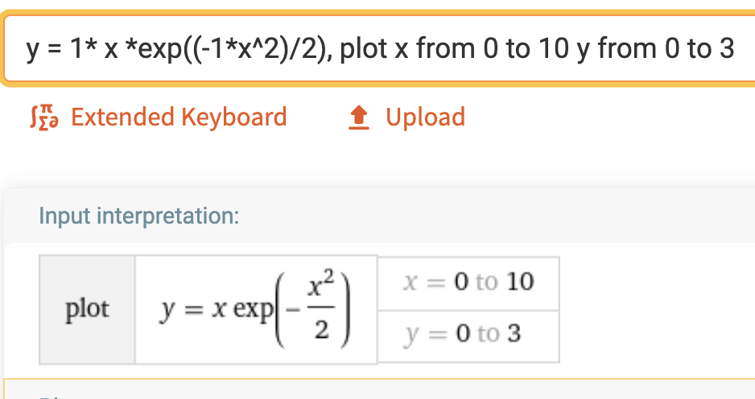
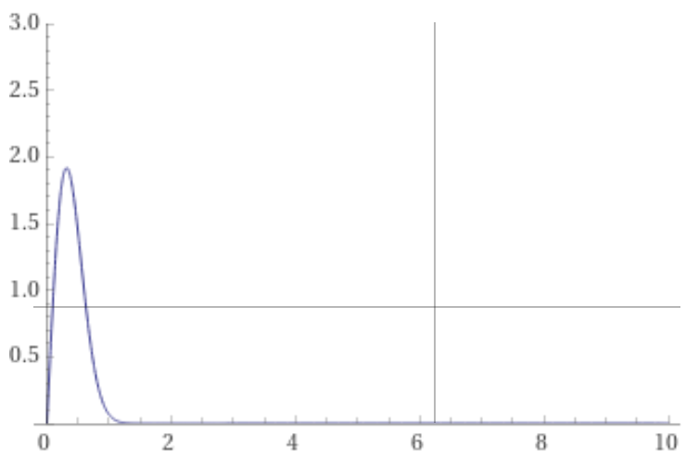
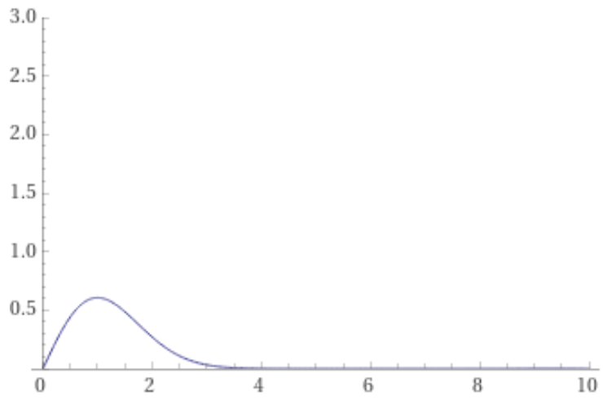
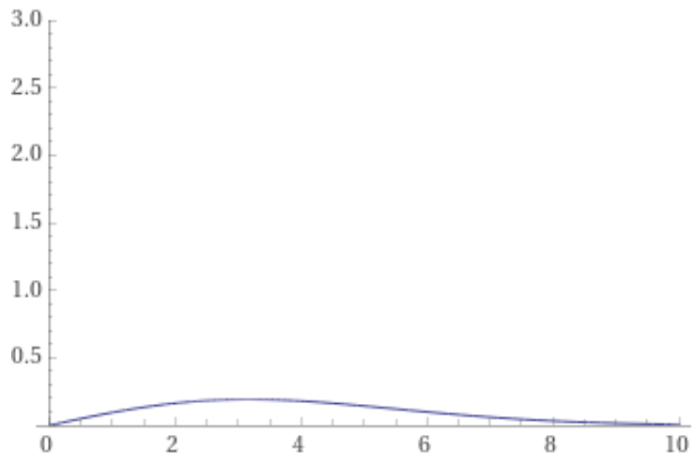
1-p_{txn}(t)
Not moved
Has moved
p_{txn}(t)
Ramp model, A is the slope at, solving the diffeq for M(t) pdf
A=0.1
A=10
A = 1

